Slide 1
IEPA Document Explorer
For Leaking UST and SRP site documents
Provides online access to Leaking Underground Storage Tank and Site Remediation Program technical documents that would otherwise require a time consuming FOIA request.
To use:
http://external.epa.illinois.gov/DocumentExplorer
Also available through the Illinois EPA Website

Slide 2
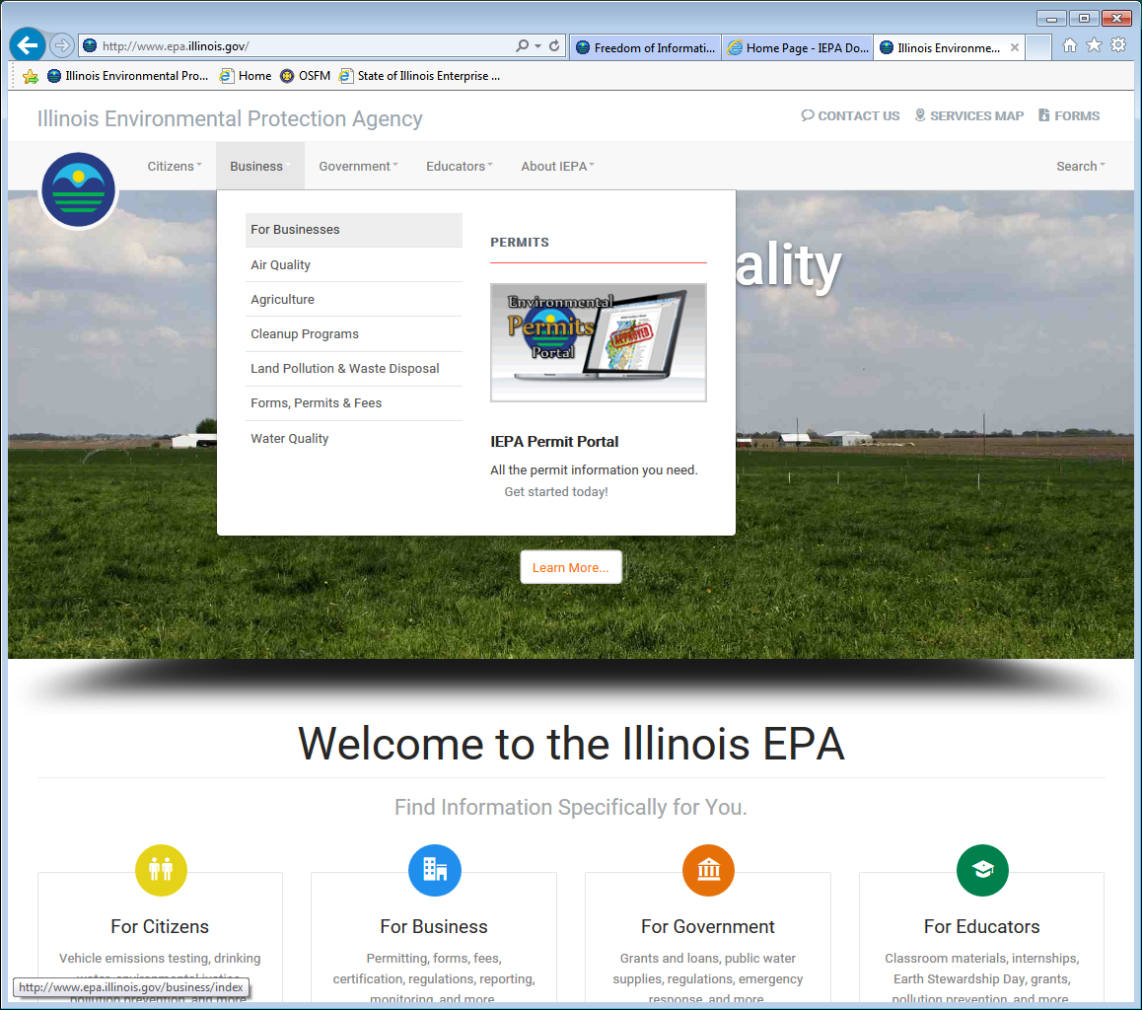
From the Illinois EPA Web Site
(http://www.epa.illinois.gov)

Slide 3
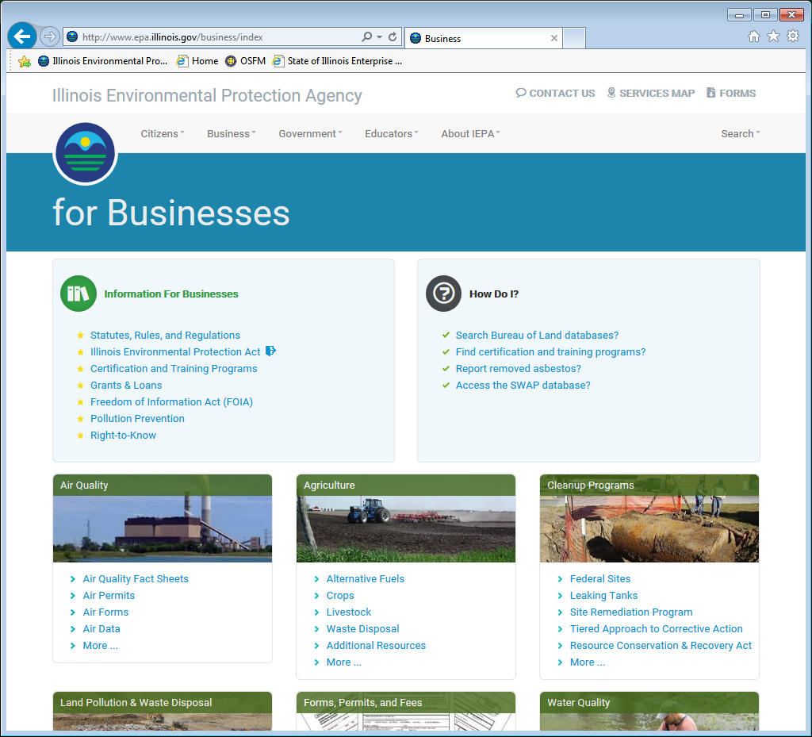

Slide 4
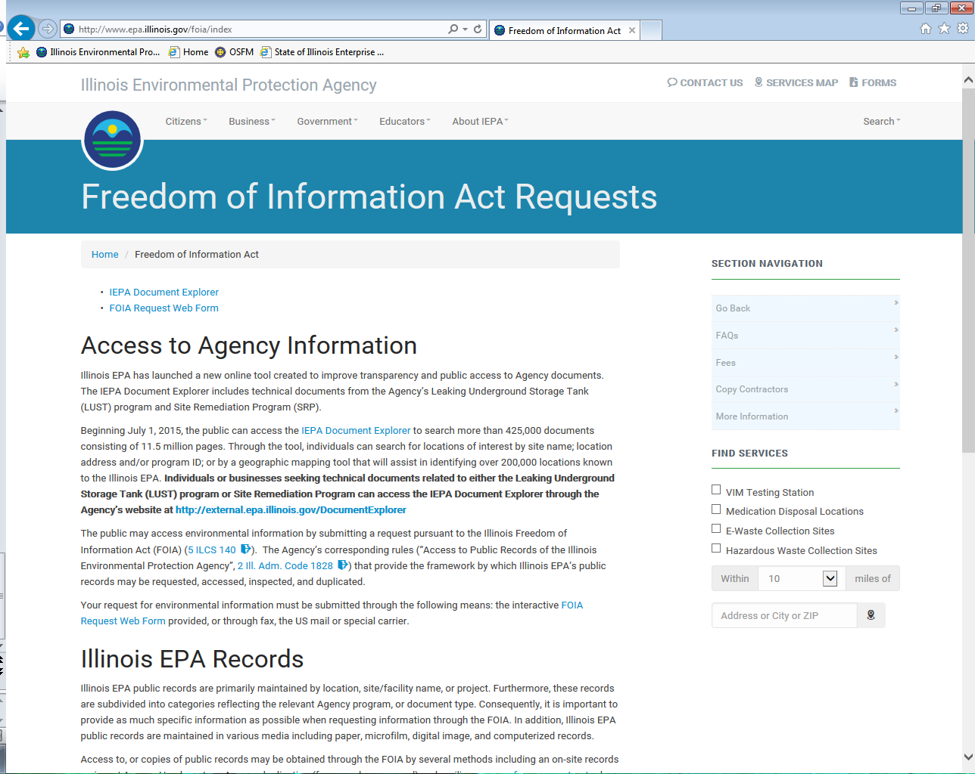

Slide 5
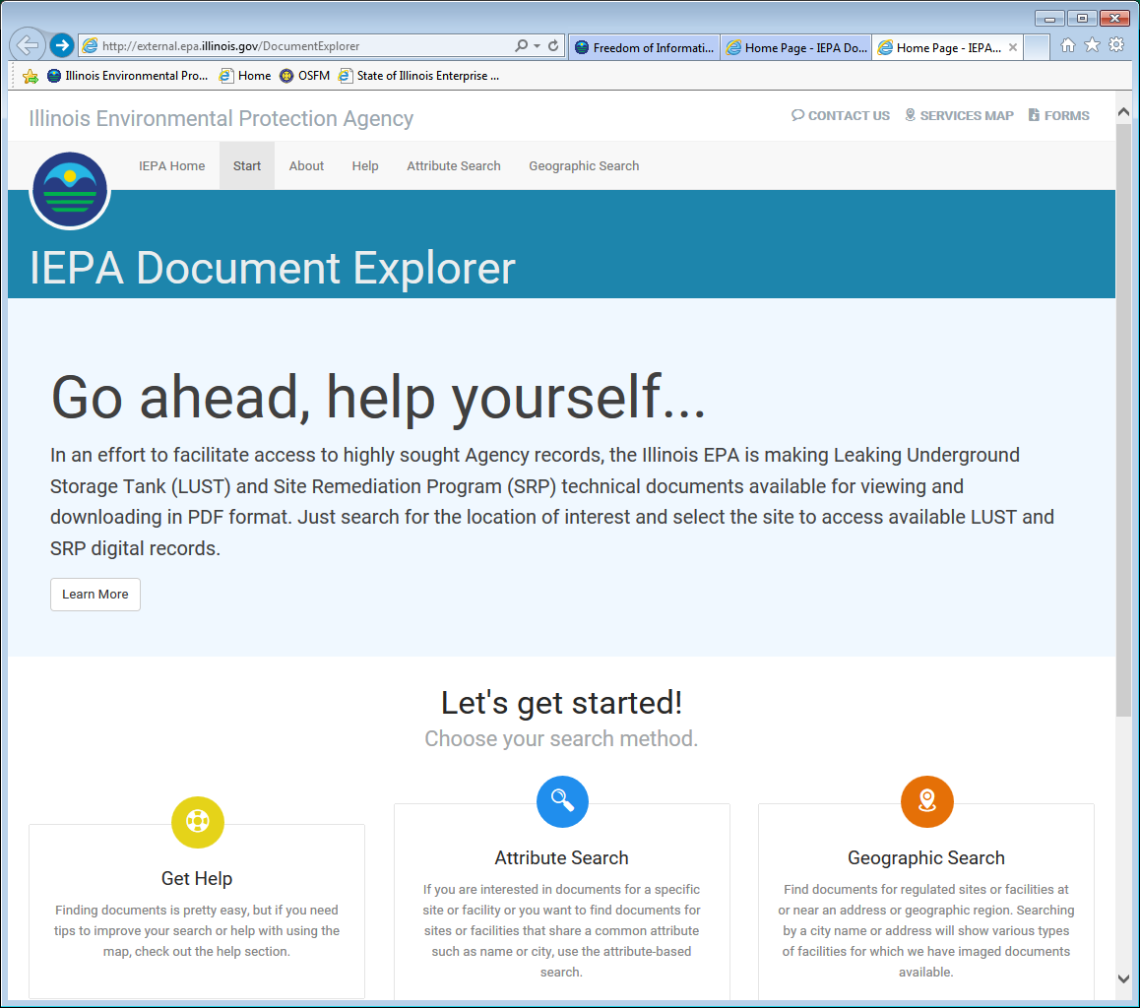

Slide 6
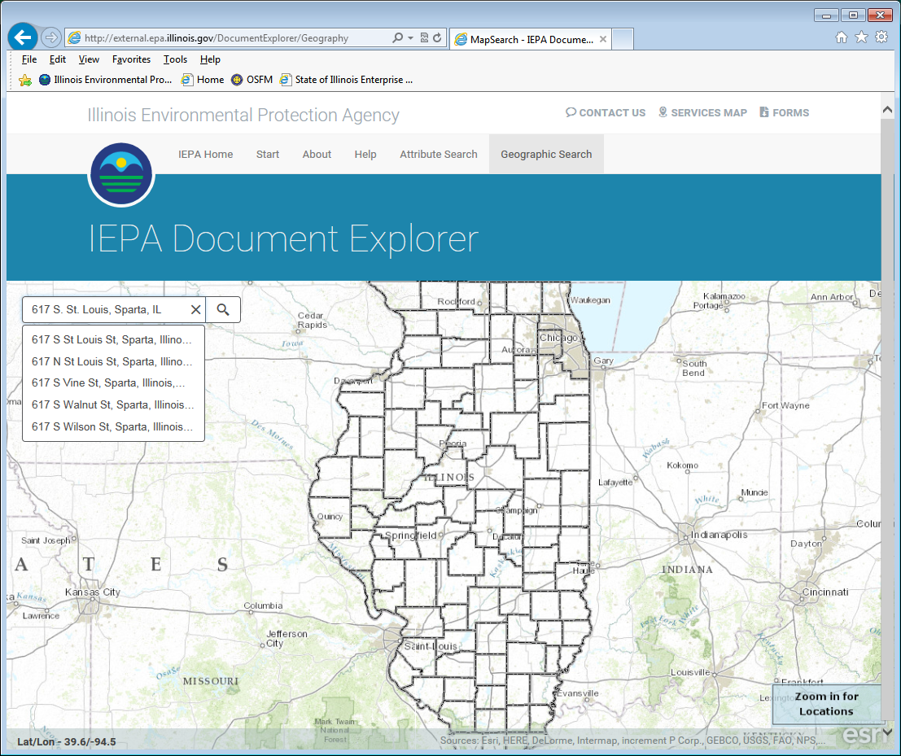
Type an address or
Zoom and Pan to find
the correct location.

Slide 7
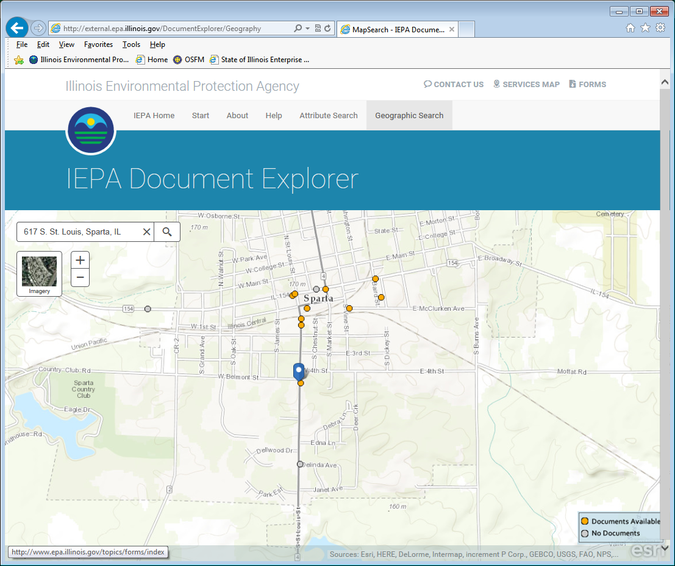
If Zoom is not working properly in your Internet Explorer browser, try adjusting the compatibility settings by clicking on the icon in the address bar.
Zoom In/Out – use Scroll Wheel
or hold Shift Key and left
mouse button to draw a box
around the desired location.
Pan – Click and hold to drag,
Release to drop
Click the yellow dot (below the blue pointer)to view associated records .
Grey dots indicate that no documents are available.

Slide 8
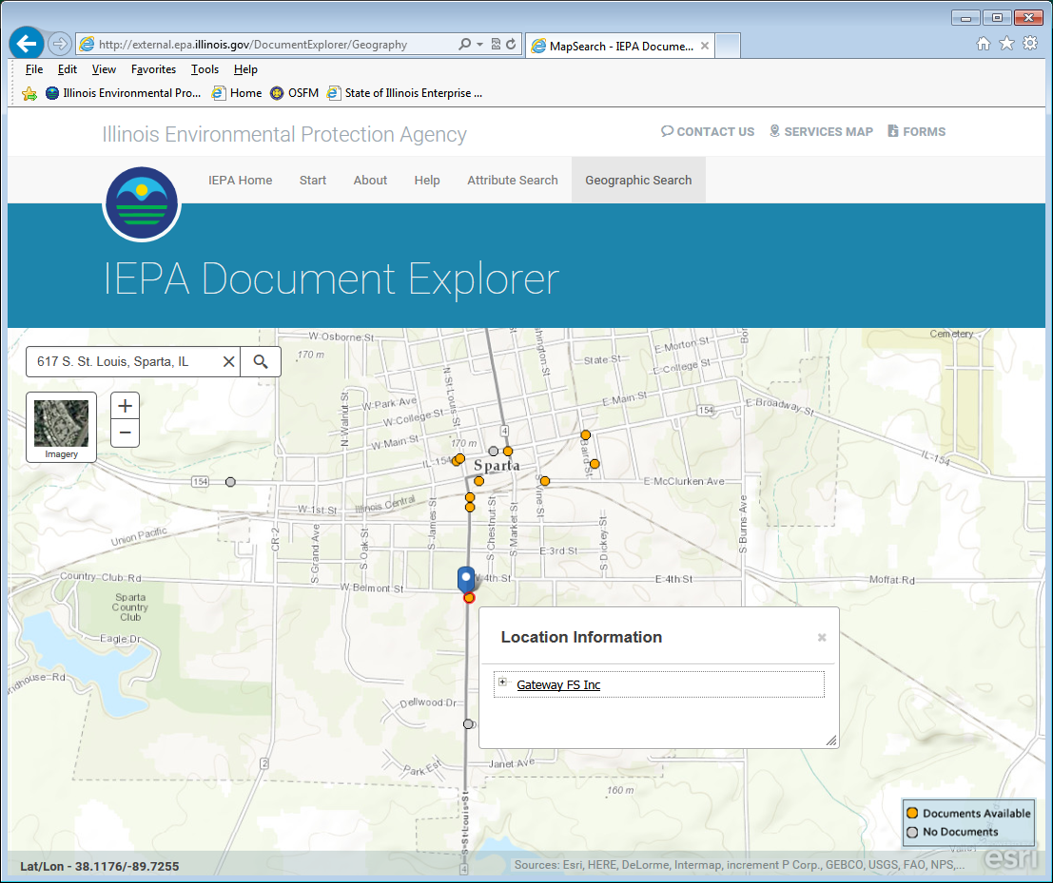

Slide 9
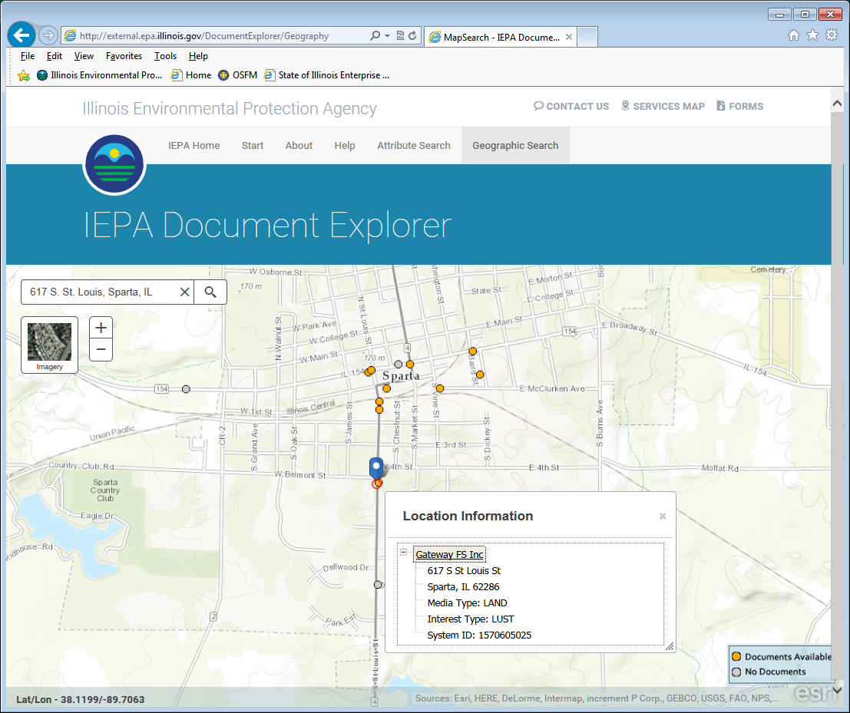

Slide 10
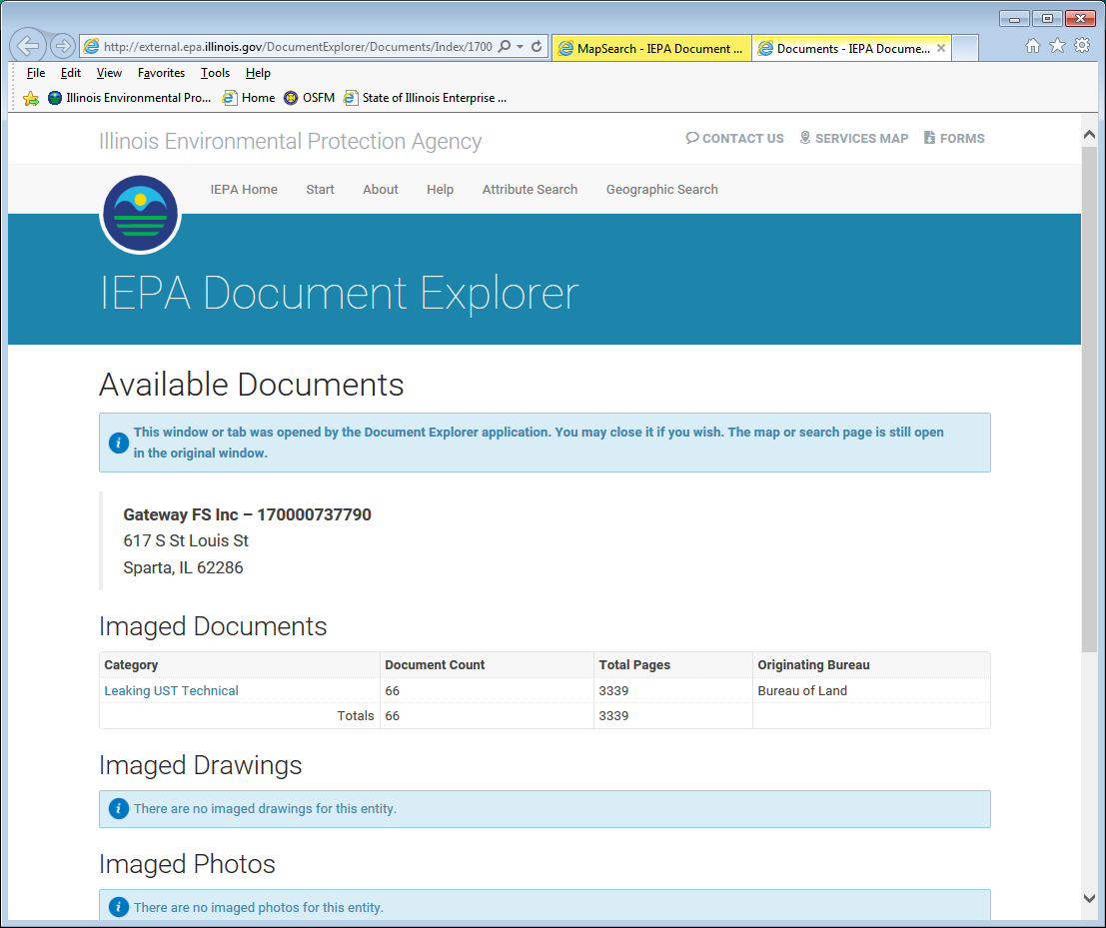

Slide 11
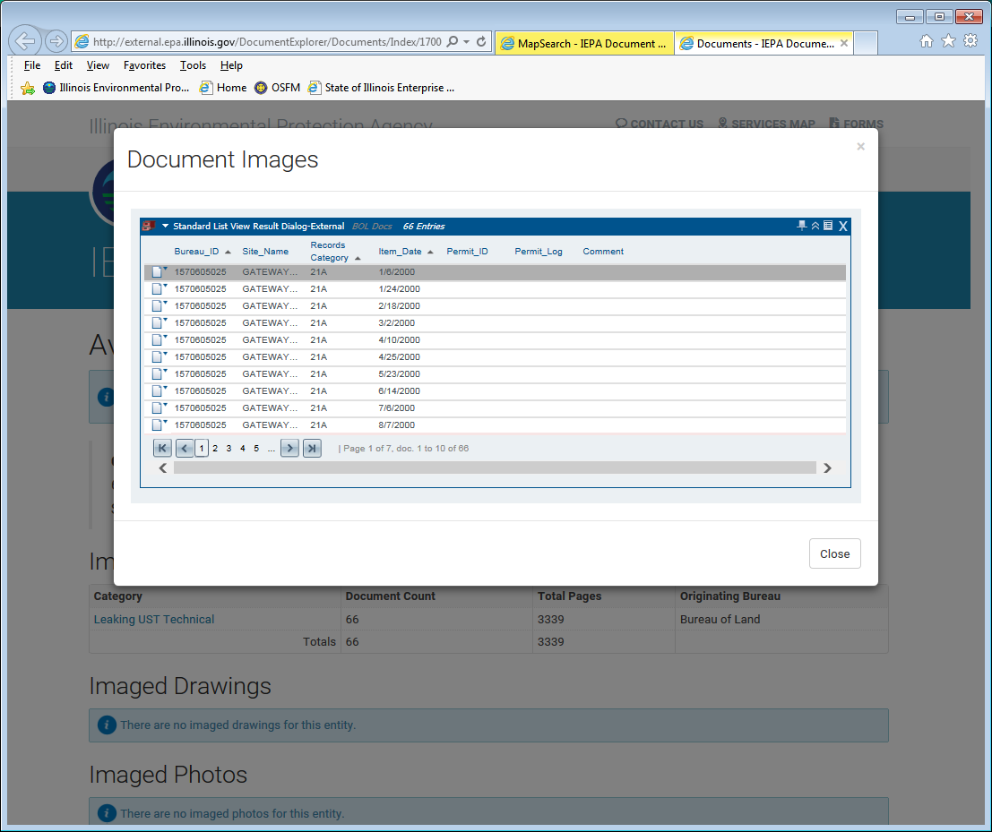
Some sites have far too many documents to search through individually. In this case, we recommend that you visit the L.U.S.T. Incident Tracking Database to find the correct documents to meet your needs. http://epadata.epa.state.il.us/land/ust/
Bureau_ID = LPC#
(write down this number before switching to a new tab and typing in the address in the text box below)

Slide 12
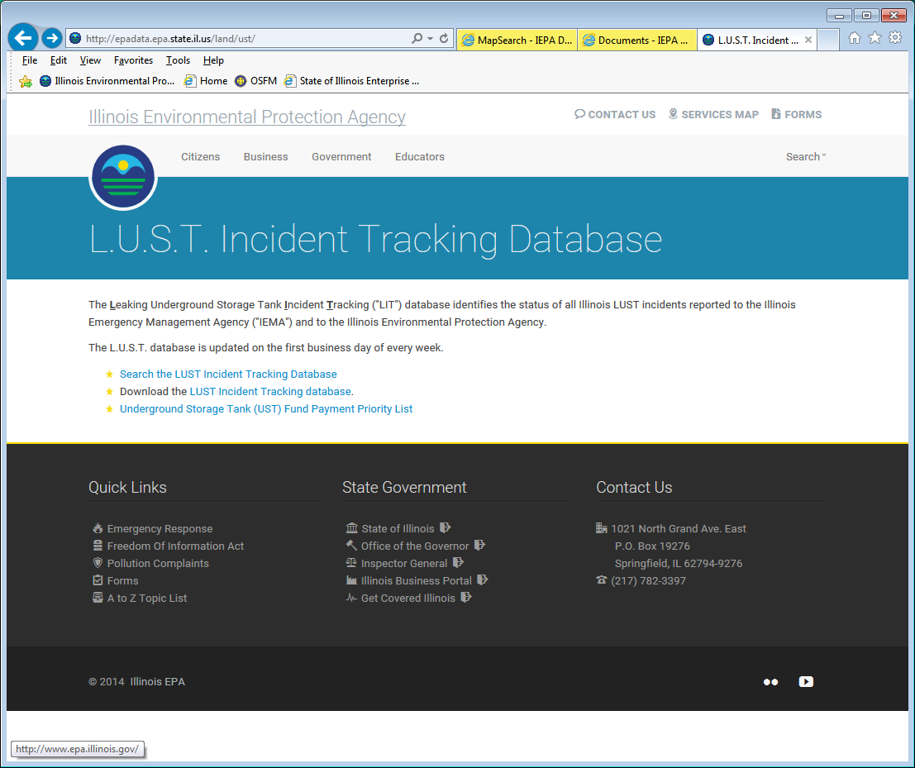

Slide 13
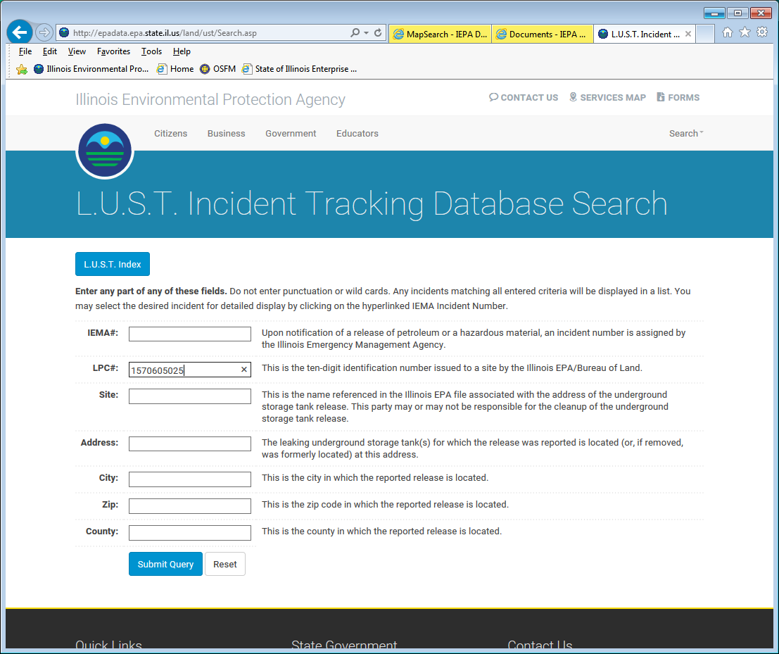
LPC#
1570605025

Slide 14
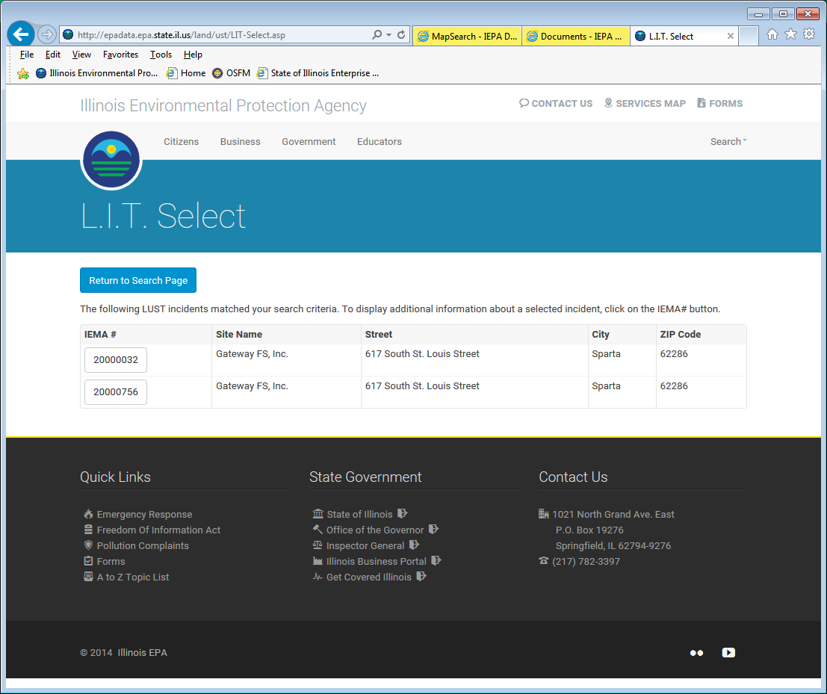

Slide 15
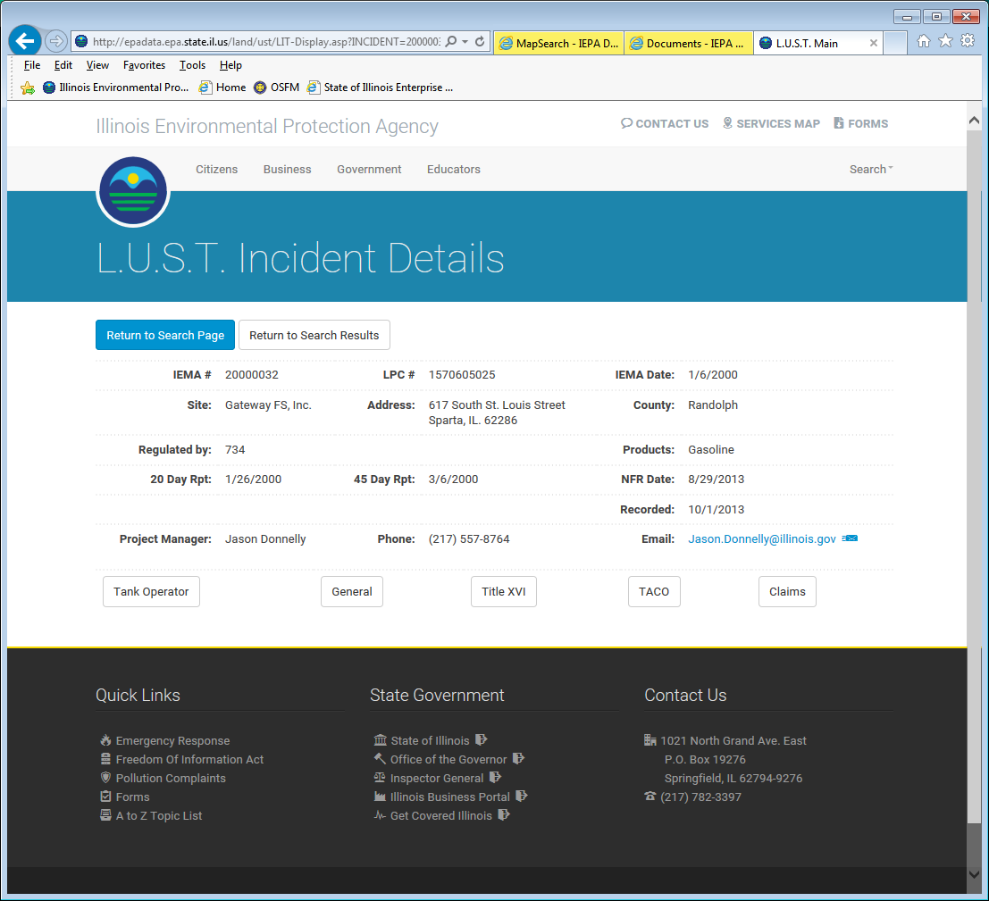

Slide 16
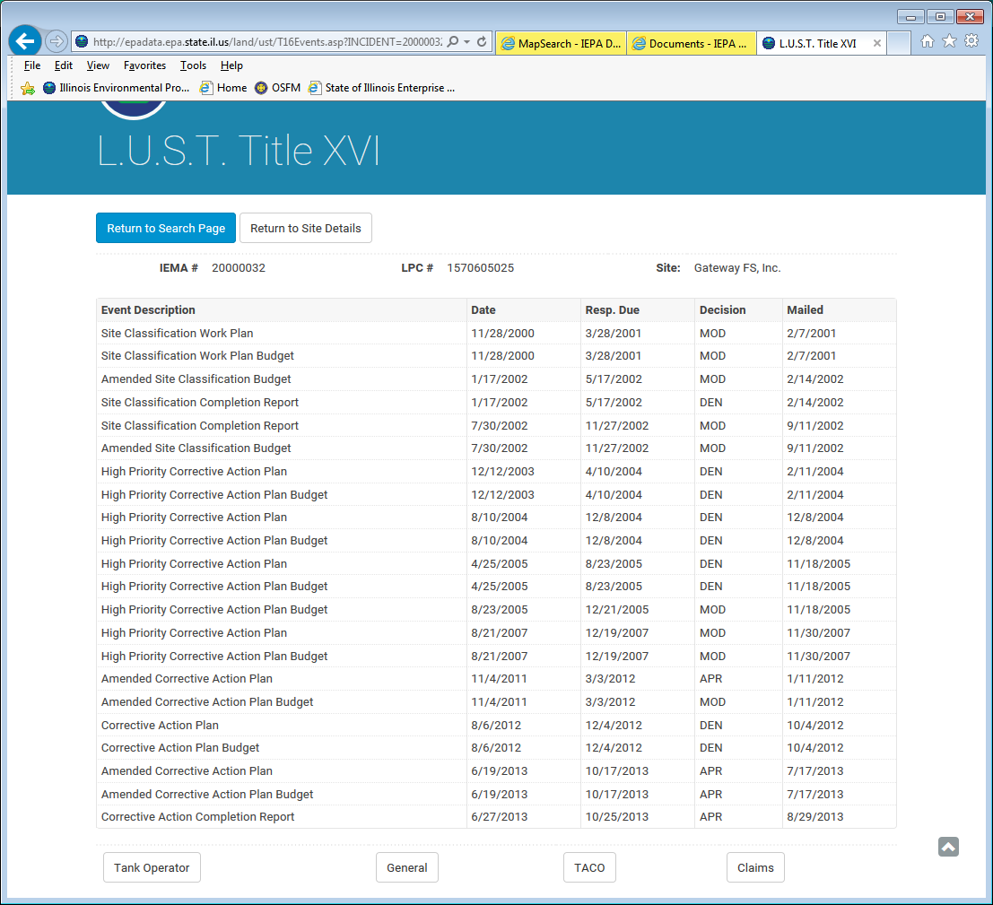

Slide 17
CACR
6/27/13

Slide 18
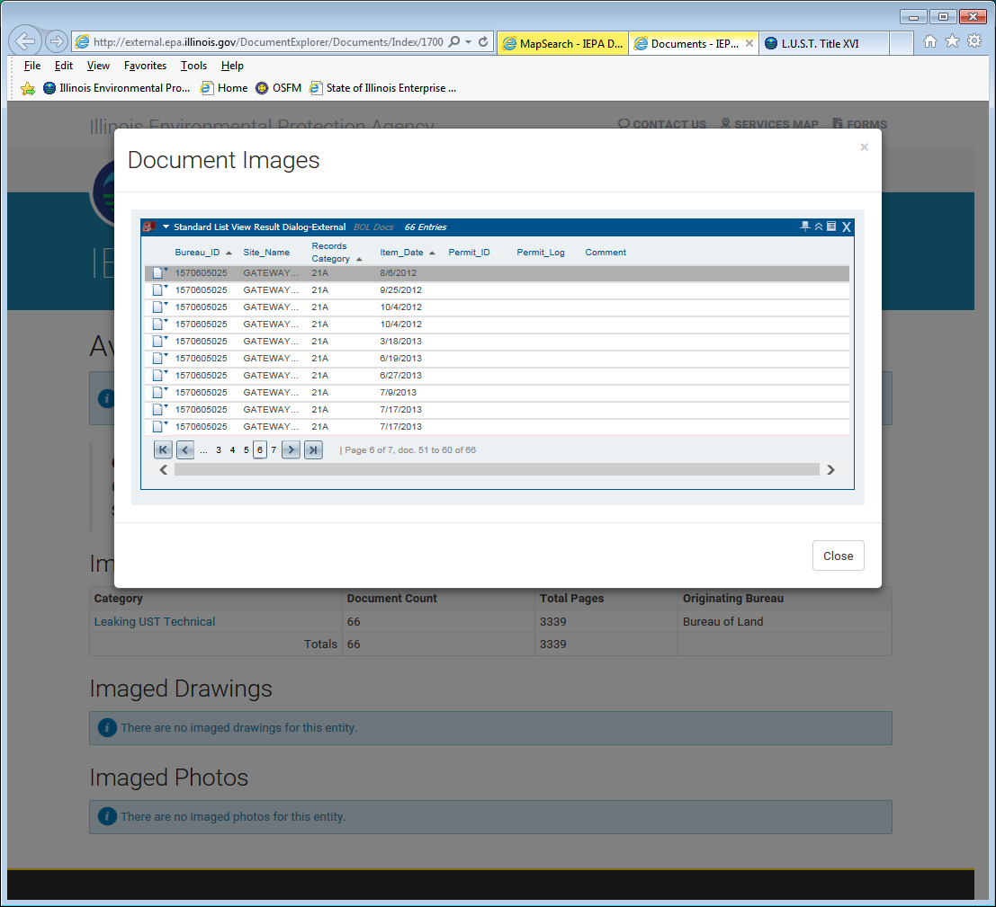
CACR
6/27/13

Slide 19
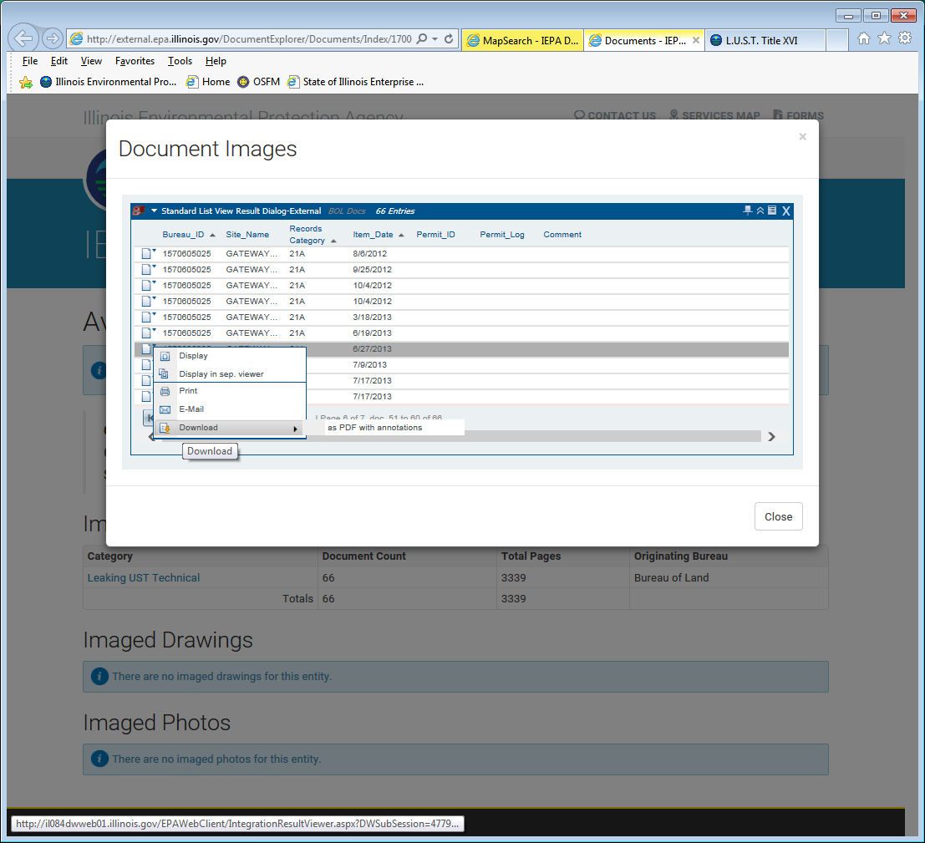

Slide 20
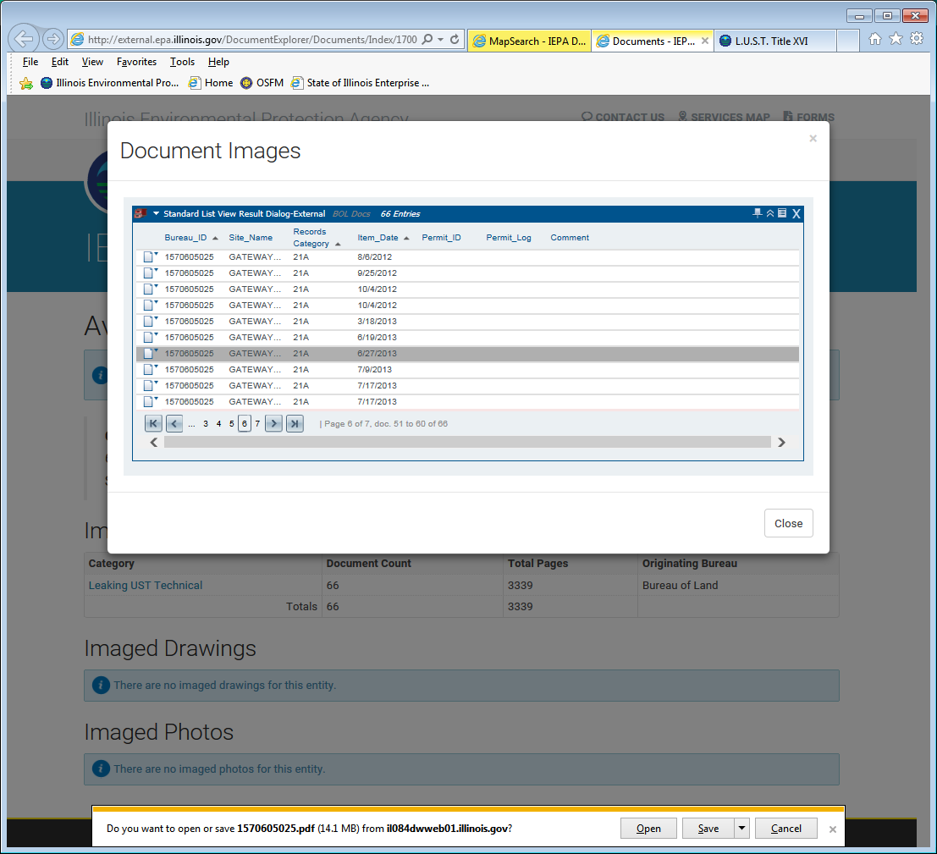

Slide 21
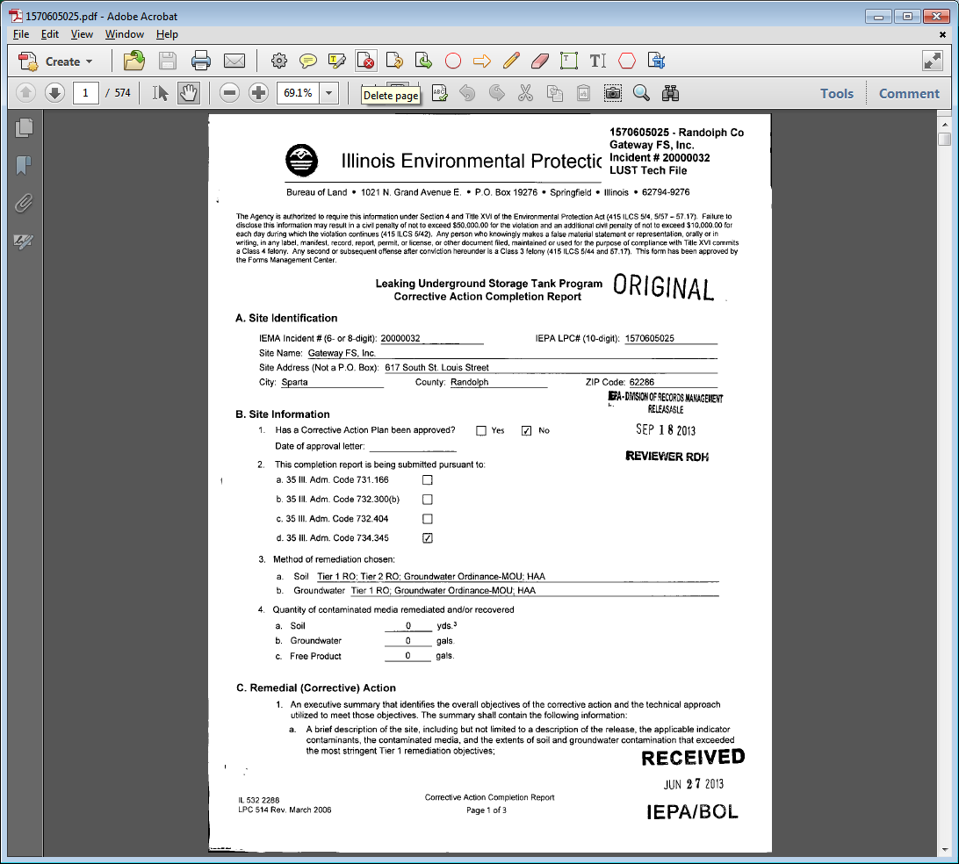

Slide 22
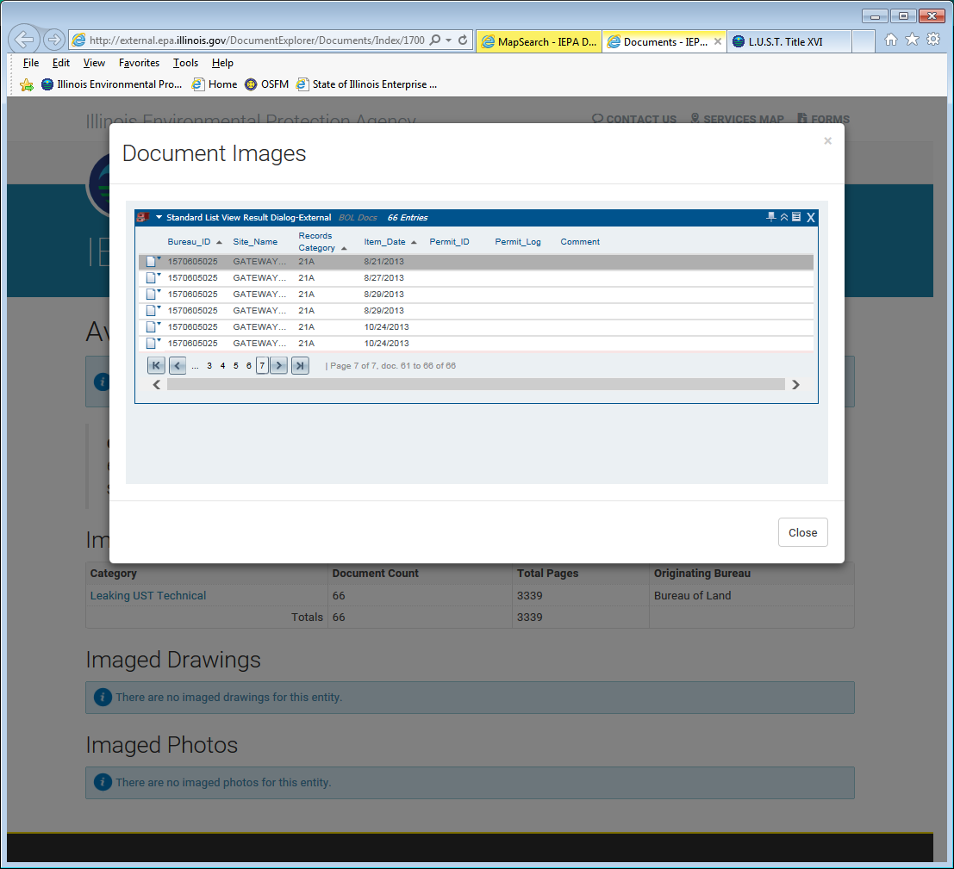
NFR
8/29/13

Slide 23
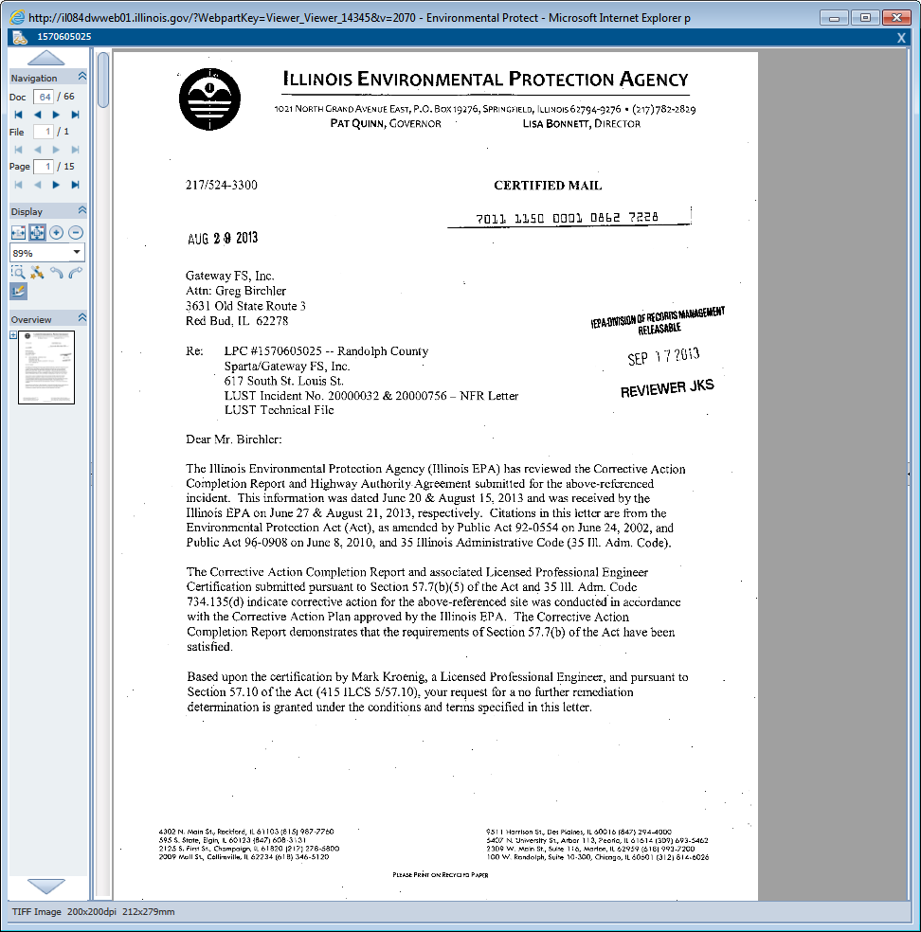

Slide 25
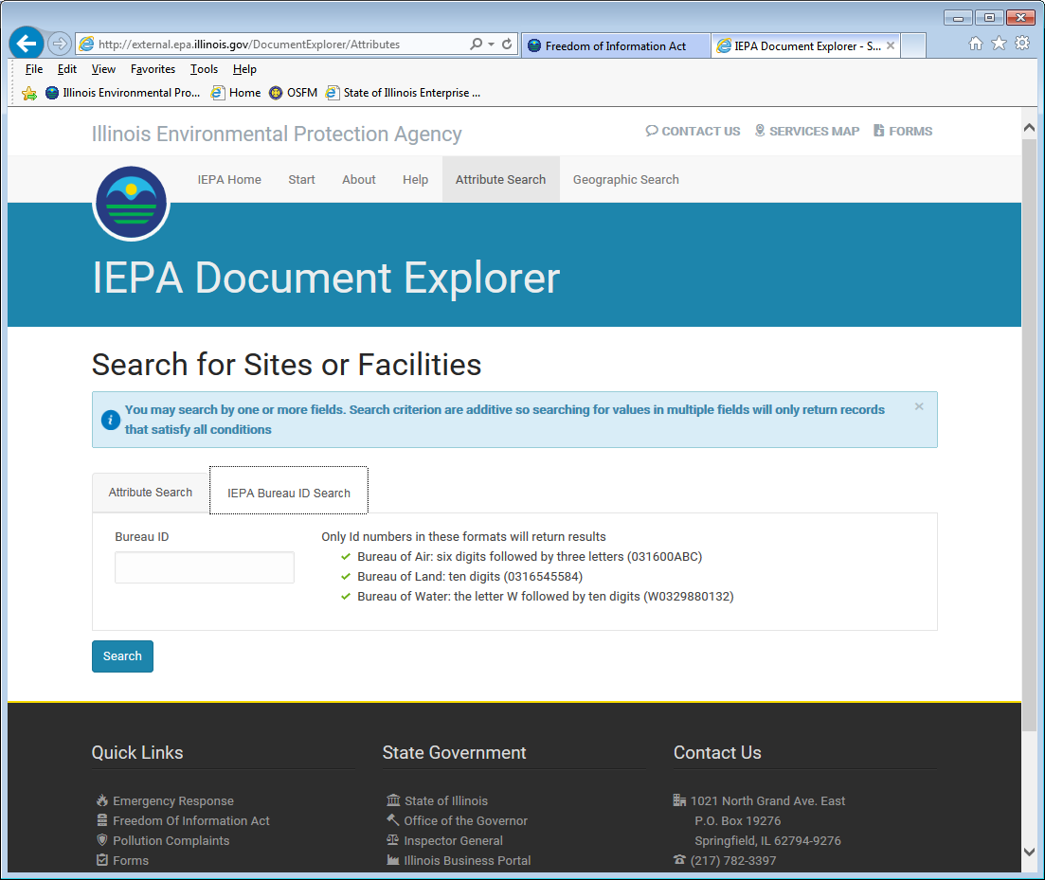

Slide 26
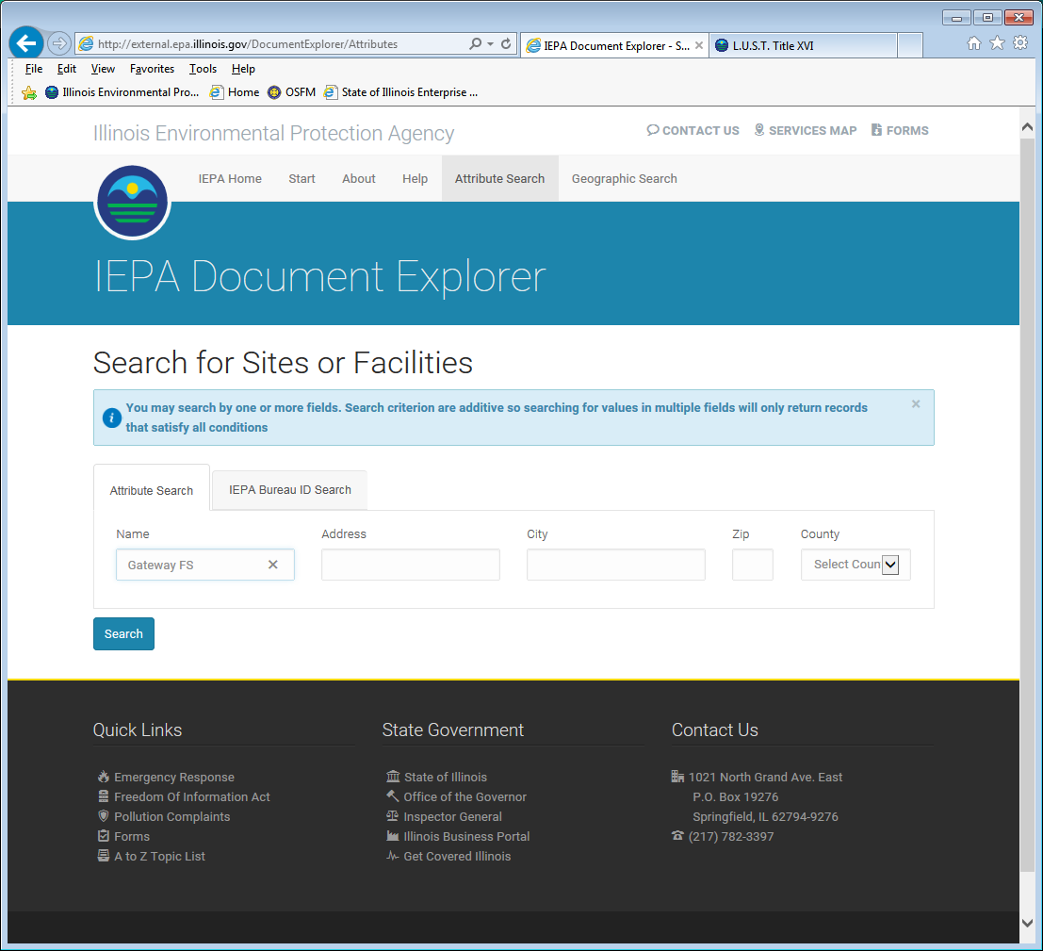

Slide 27
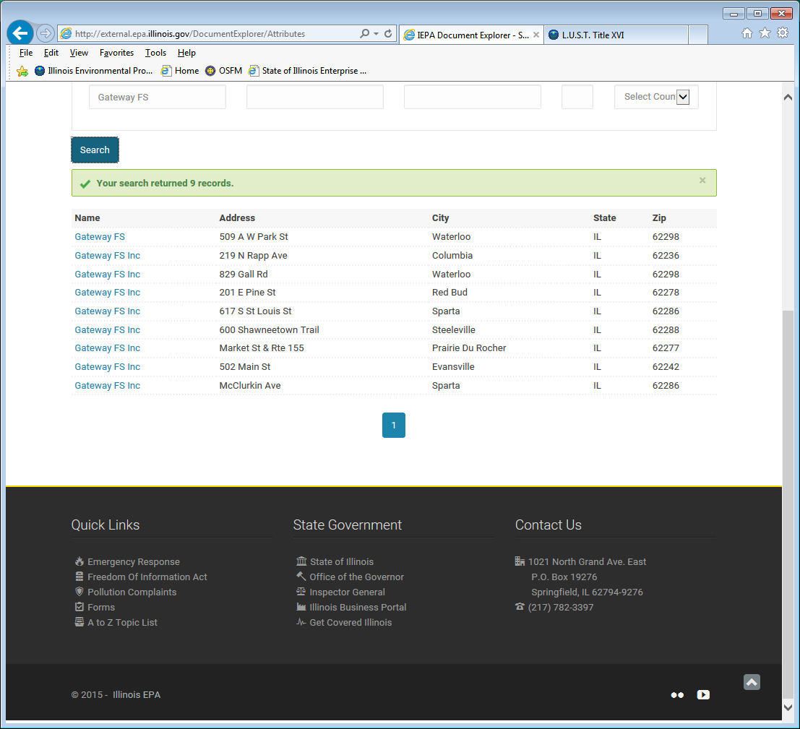

Slide 28
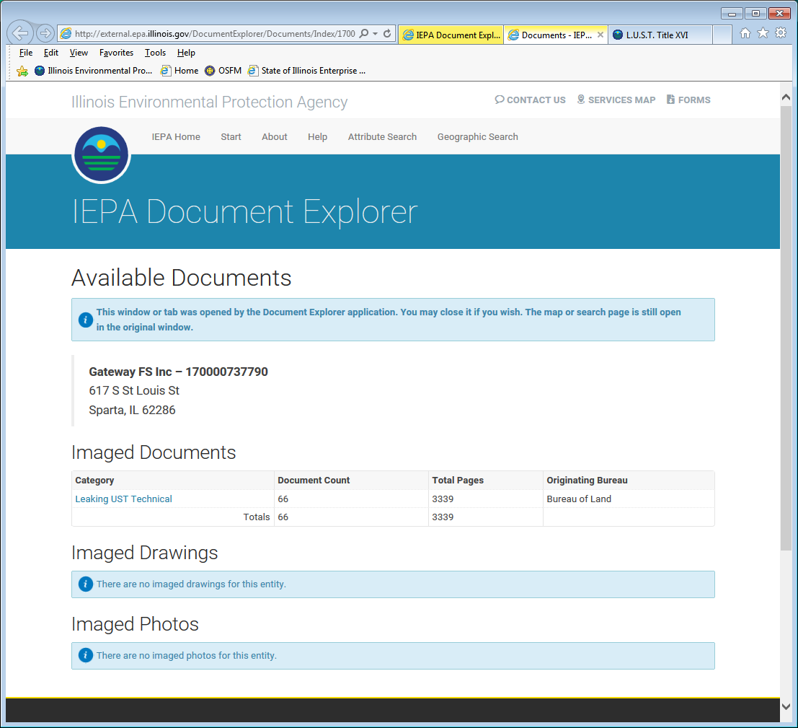

Slide 29
If you run into problems at a later time, please feel free to contact Suzanne Boring at (217)558-4071 or you may call the Leaking UST Project Manager On-Call at (217)524-6941.
Questions?

